Slide 2
Build your Service Using AWS Tech!
Uttara Shekar
Melonia Mendonca
Community News Bulletin

Slide 3
Agenda
Brief overview of AWS technologies
Details on what we are building
Workshop Setup
Get Hands on with AWS
Questions and Answers

Slide 4
Prerequisite
Create an AWS account
Go to https://aws.amazon.com
Navigate to “Sign in to Console” on the far top right
Click on “Create a new AWS account”
Install Python on your terminal
Go to https://www.python.org/downloads/
Download the latest version of Python
Install NPM
Go to https://www.npmjs.com/get-npm
Click on the Download Node.js and npm button
Install Git
Go to https://git-scm.com/downloads

Slide 5
Terminology

Slide 6
Web service
Scalability
Availability
API

Slide 7
AWS Technologies

Slide 8
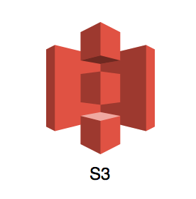
Amazon S3
Store large amounts of data
Easy retrievals
Scalable, high availability, secure
Notes:
In simple words, Amazon S3 is a web service that allows you to store and retrieve large amounts of data. Due to its industry leading performances, high availability and security, Amazon S3 allows your services to scale based on the requirement.

Slide 9
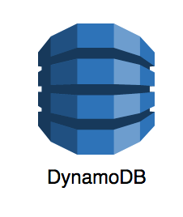
Amazon DynamoDB
NoSQL database
Key-value store
High availability, Scalable, Secure
Fast and consistent
Notes:
Amazon DynamoDB is a fully managed noSQL database. NoSQL technology is a modern type of data modeling technology for databases. Another type of database technology that a lot of you might be more familiar with is SQL, which is known for providing scalable results for ad-hoc or complex queries that you’re not familiar with. NoSQL, on the other hand, is perfect for use cases where we know what queries we need to make on the database. It’s mostly like a key-value store. As all AWS technologies, it is scalable and secure and also fast and convenient to use.

Slide 10
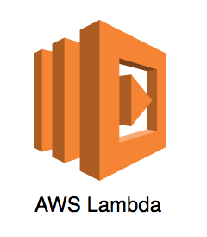
AWS Lambda
Serverless architecture
Manages scaling
Load balancing
Event driven architecture
Highly available, scalable, secure
Notes:
AWS Lambda is AWS’s solution to serverless compute. Serverless compute does not mean there are no servers on which your program / code runs.

Slide 11
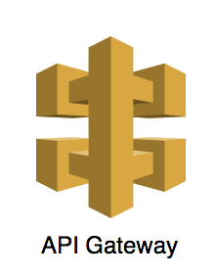
Amazon API Gateway
API management tool
Front door for requests
High availability, scalable and secure
Notes:
.

Slide 12
AWS Amplify
Powerful tools to build secure and scalable applications
Builds the bare-bones of back-end
Provides a framework for front-end
Notes:
AWS Amplify isn’t a “web service”.

Slide 13
Install AWS Amplify
npm install -g @aws-amplify/cli

Slide 14
What are we building?

Slide 15
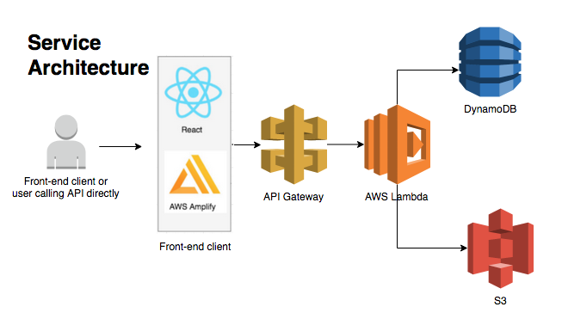
Service Architecture: Community News Bulletin
Notes:
This service will be backed with the most popular AWS technologies that we just went over. We will be using
Amazon S3 to hold the content of our news articles. Since these articles can be large, just like images, and so Amazon S3 is the perfect candidate for storing this information
Amazon DynamoDB to hold our metadata that we want to easily query, like the title of the article, the location of the content in S3 and other such information or metadata pertaining to the news article.
AWS Lambda will be our event-driven, serverless compute, that will respond to requests made by the client and do the needful, and interact with DynamoDB and S3, as required.
Amazon API Gateway will be our API Gateway.
AWS Amplify will help us quickly generate our back-end resources as also a framework for our front end application.
I’m going to explain the journey of a request made to the back-end, so pay close attention.
In order to make a request, a user first logs onto the webpage that is on your browser. There they perform certain actions like loading the webpage to read the articles or adding a new article of their own. The front-end application converts these actions performed by the user into the respective APIs and calls the service on behalf of the user. So a network call is made to your service.
This call reaches the API gateway which processes the request and forward it to the relative AWS Lambda function. For our workshop today, we will be hosting each API on a separate Lambda function. Each lambda now knows its functionality.
Now, if it is a write API, like adding a news article, the functionality of that Lambda would be add this information into DynamoDB and S3.
If it is a read API, like loading the webpage, then the lambda retrieves information from backend databases aka DynamoDB and S3 and return it back to the front-end framework.
The front-end framework will “prettify” your response and provide that to the end user.

Slide 16
Setup
https://github.com/uttarashekar/ghc_2020_aws_workshop/blob/master/README.md
Notes:
AWS Identity and Access Management (IAM) is a web service for securely controlling access to AWS services. With IAM, you can centrally manage users, security credentials such as access keys, and permissions that control which AWS resources users and applications can access.
AWS Cloudformation is an AWS service that builds and provisions your AWS infrastructure, repeatedly, and in our case, predictably. It does this by using a template file to create and delete a collection of resources. Amplify takes advantage of this AWS resource to build your back-end resources. So in simpler words, AWS Amplify calls Cloudformation provided API which helps create resources for us.

Slide 17
Build Service Components

Slide 18
Activity 1 – ReadStories API

Slide 19
Activity 2 – CreateStory API

Slide 20
What can you build?

Slide 21
Do It Yourself!
ReadStory API
LikeOrComment API
Add a Local Businesses Table
Move Create Story to a page with authentication

Slide 22

Thank You!
https://www.linkedin.com/in/uttara-shekar-0aa20645/
https://www.linkedin.com/in/melonia-mendonca-b9b17b33/

